Slide 1
Week 12 Lecture No. 24
Visual Programming C# & .Net Framework
Course Instructor: Dr. Malik Daler Ali Awan
01/10

Slide 2
Topic
Viewing the Data from Database
Some other Controls
02/10

Slide 3
Viewing/Selecting Data From Database
How to Select/View Data from Table using Window Form?
After creating , inserting data, now its time to view the inserted record.
Steps
Use DataGridView Control to Display Data
Draw View/Display Button
Write the code (query )behind the Button
03/10

Slide 4
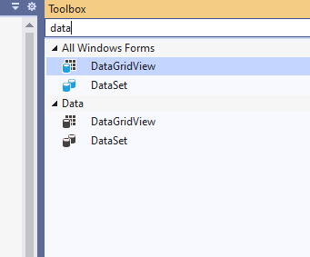
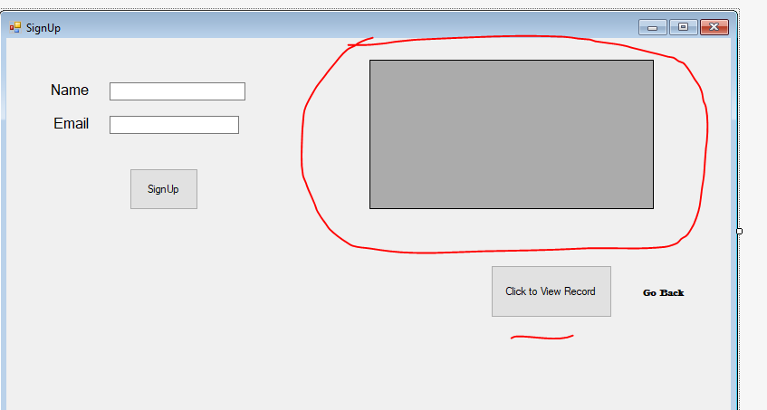
DataGridView
01/02
02/02
04/10

Slide 5
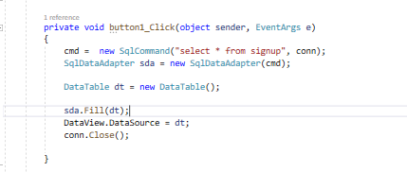
Code
Create cmd object to communication with database using “SqlCommand” Class
05/10

Slide 6
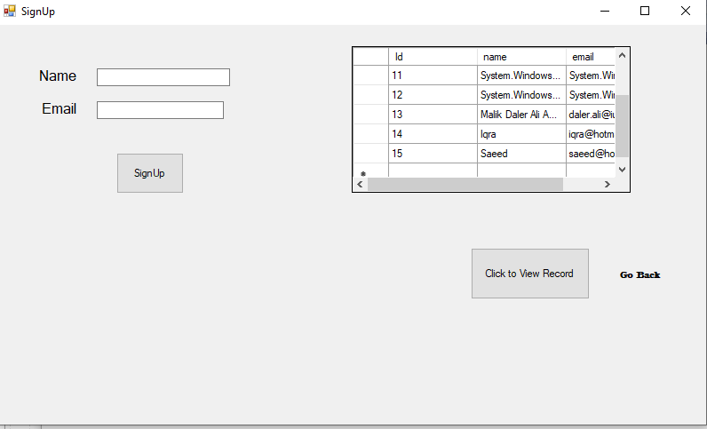
Result
06/10

Slide 7
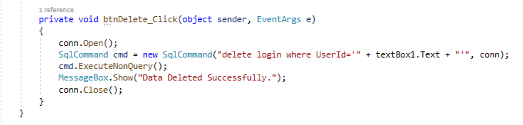
Delete Data From a Table
Draw a text box to input the Id (you may use name, or another filed)
Draw a button label with Delete
Use correct field name of table
Use the correct name of input box.
Must use the conn object to connect with database.
Note: Here the Name “login” is static, you may used your dynamic (custom) table name.
07/10

Slide 8
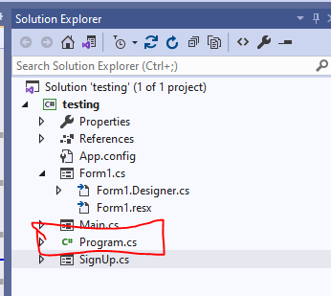
How to set the Starting page?
We can set any window form as a starting page by following these steps.
Go To Solution Explorer
Find out the File Named as “Program.CS”.
Open it and Write the Window Form’s Name, that you want to execute as a starting Window.
08/10

Slide 9

Starting Window From
Few Other Controls/Methods
This.Close(); // It is used behind the close system button to close the application.
This.hide() // It is usae to hide the current form.
Activity: Explore the Internet to learn more controls.
Add more Fields in Table
Perform Some Mathematical Calculations on Data.
Maintain the Records.
09/10

Slide 10
Thank you!
10/10

